Slide 1
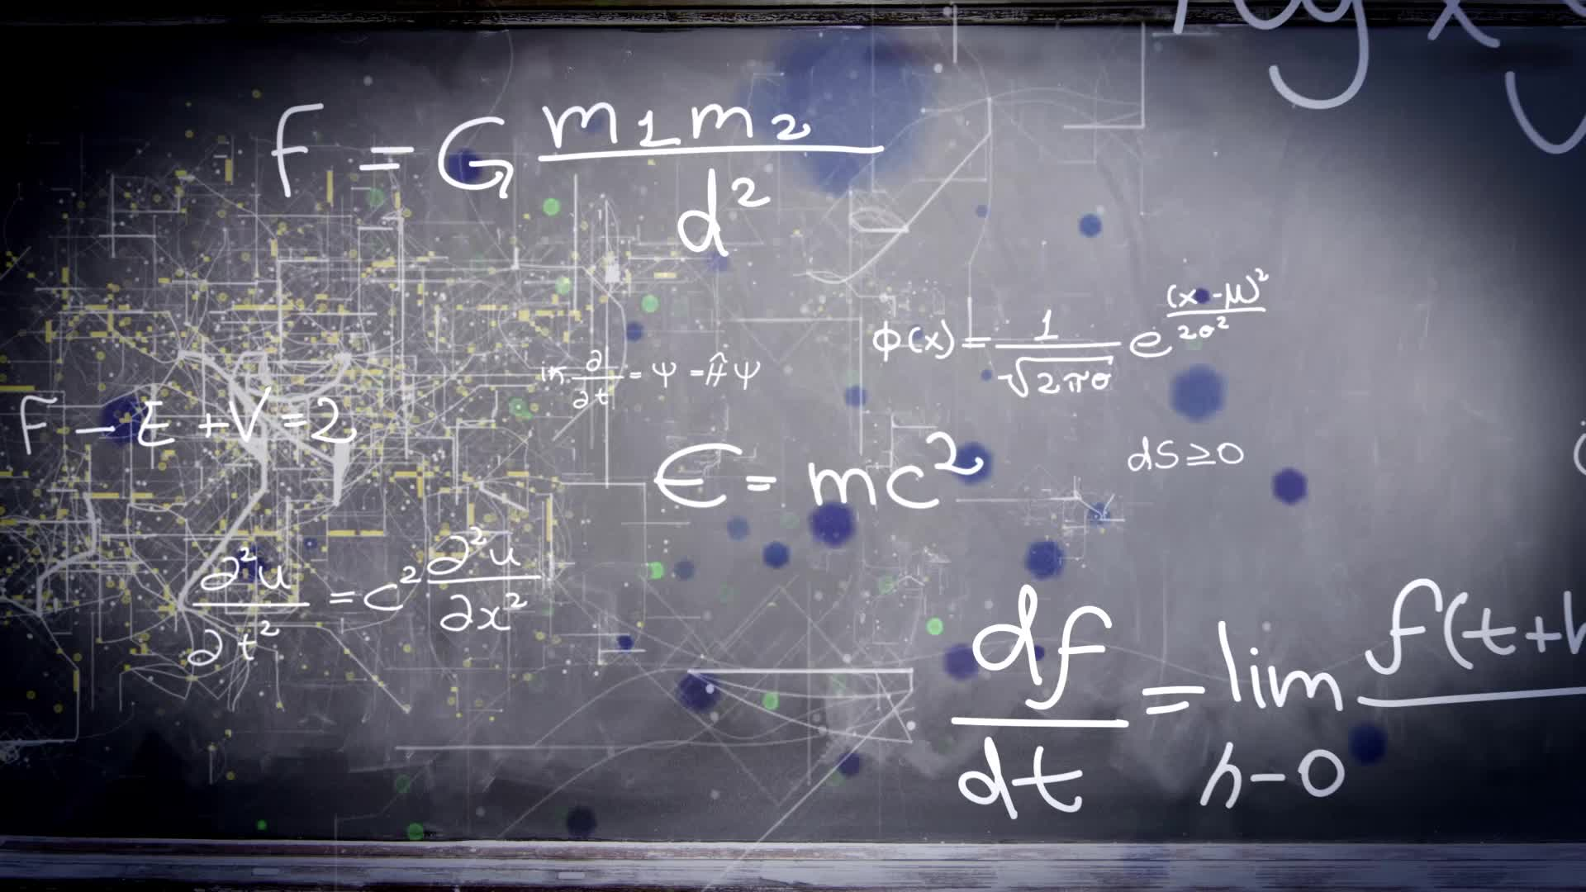
A Systems Engineering Perspective of DTR
Focusing on Systems Architecture

Slide 2
What is systems engineering?
“Systems Engineering is a transdisciplinary and integrative approach to enable the successful realization, use, and retirement of engineered systems, using systems principles and concepts, and scientific, technological, and management methods.”
-INCOSE Definition
What is an engineered system?
A system designed or adapted to interact with an anticipated operational environment to achieve one or more intended purposes while complying with applicable constraints
https://www.incose.org/about-systems-engineering/system-and-se-definition/systems-engineering-definition
Notes:
System Engineering is responsible :
establishing, balancing and integrating stakeholders’ goals, purpose and success criteria, and defining actual or anticipated customer needs, operational concept and required functionality
establishing an appropriate process approach and governance structures, considering the levels of complexity, uncertainty, change, and variety;
generating and evaluating alternative solution concepts and architectures;
baselining and modelling requirements and selected solution architecture for each phase of the endeavor;
performing design synthesis and system verification and validation;
Considers both the problem and solution domains, to identify the role that the parts and the relationships between the parts play with respect to the overall behaviour and performance of the system
Determines how to balance all of these factors to achieve a satisfactory outcome.

Slide 3
What does this mean?
Systems Engineering is
A process to design the most suitable system
To meet your intended purpose (need)
For the required environment
Given all of your constraints
Other aspects of SE we don’t care as much about
Ultimately, the DTR “problem” is a Systems Engineering “problem”

Slide 4
Why Systems Engineering?
We only have so much time
We only have so much money
We have a limited number of team members
We have to use our resources wisely
“Better is the enemy of good enough”

Slide 5
What is our purpose*?
Defeat other teams in a one-on-one game of autonomous blimp soccer
How do we defeat them?
Score goals
Keep them from scoring goals
Win the Game
Score Goal
Deny Goal
*Purpose = problem, requirement, need (can be called many things)

Slide 6
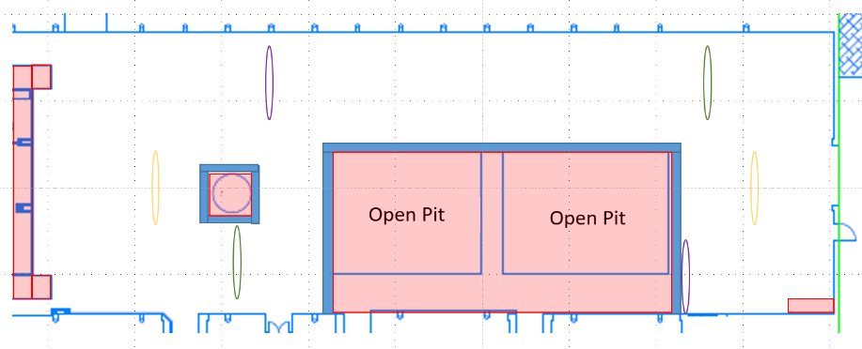
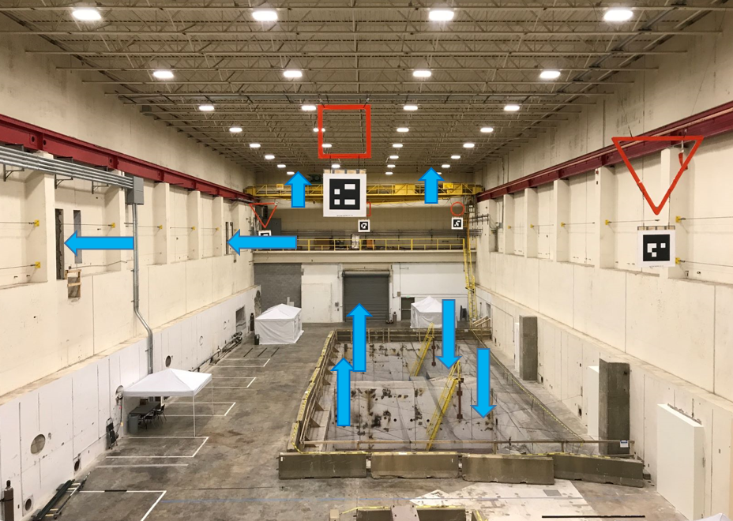
What is the required environment?
Approx 180ft
Indoors
Large open highbay
Variable heights
Rafters in ceiling
Multiple catch points
High volume air flow
LED lighting
Approx
67ft

Slide 7
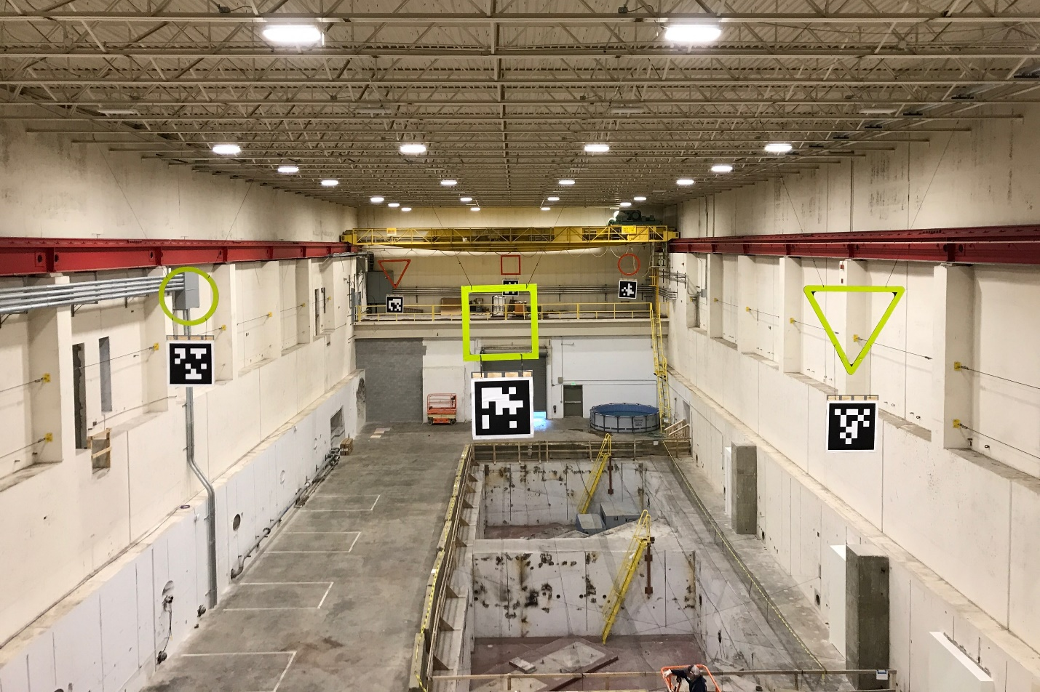
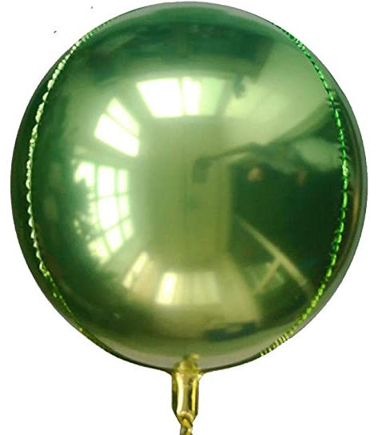
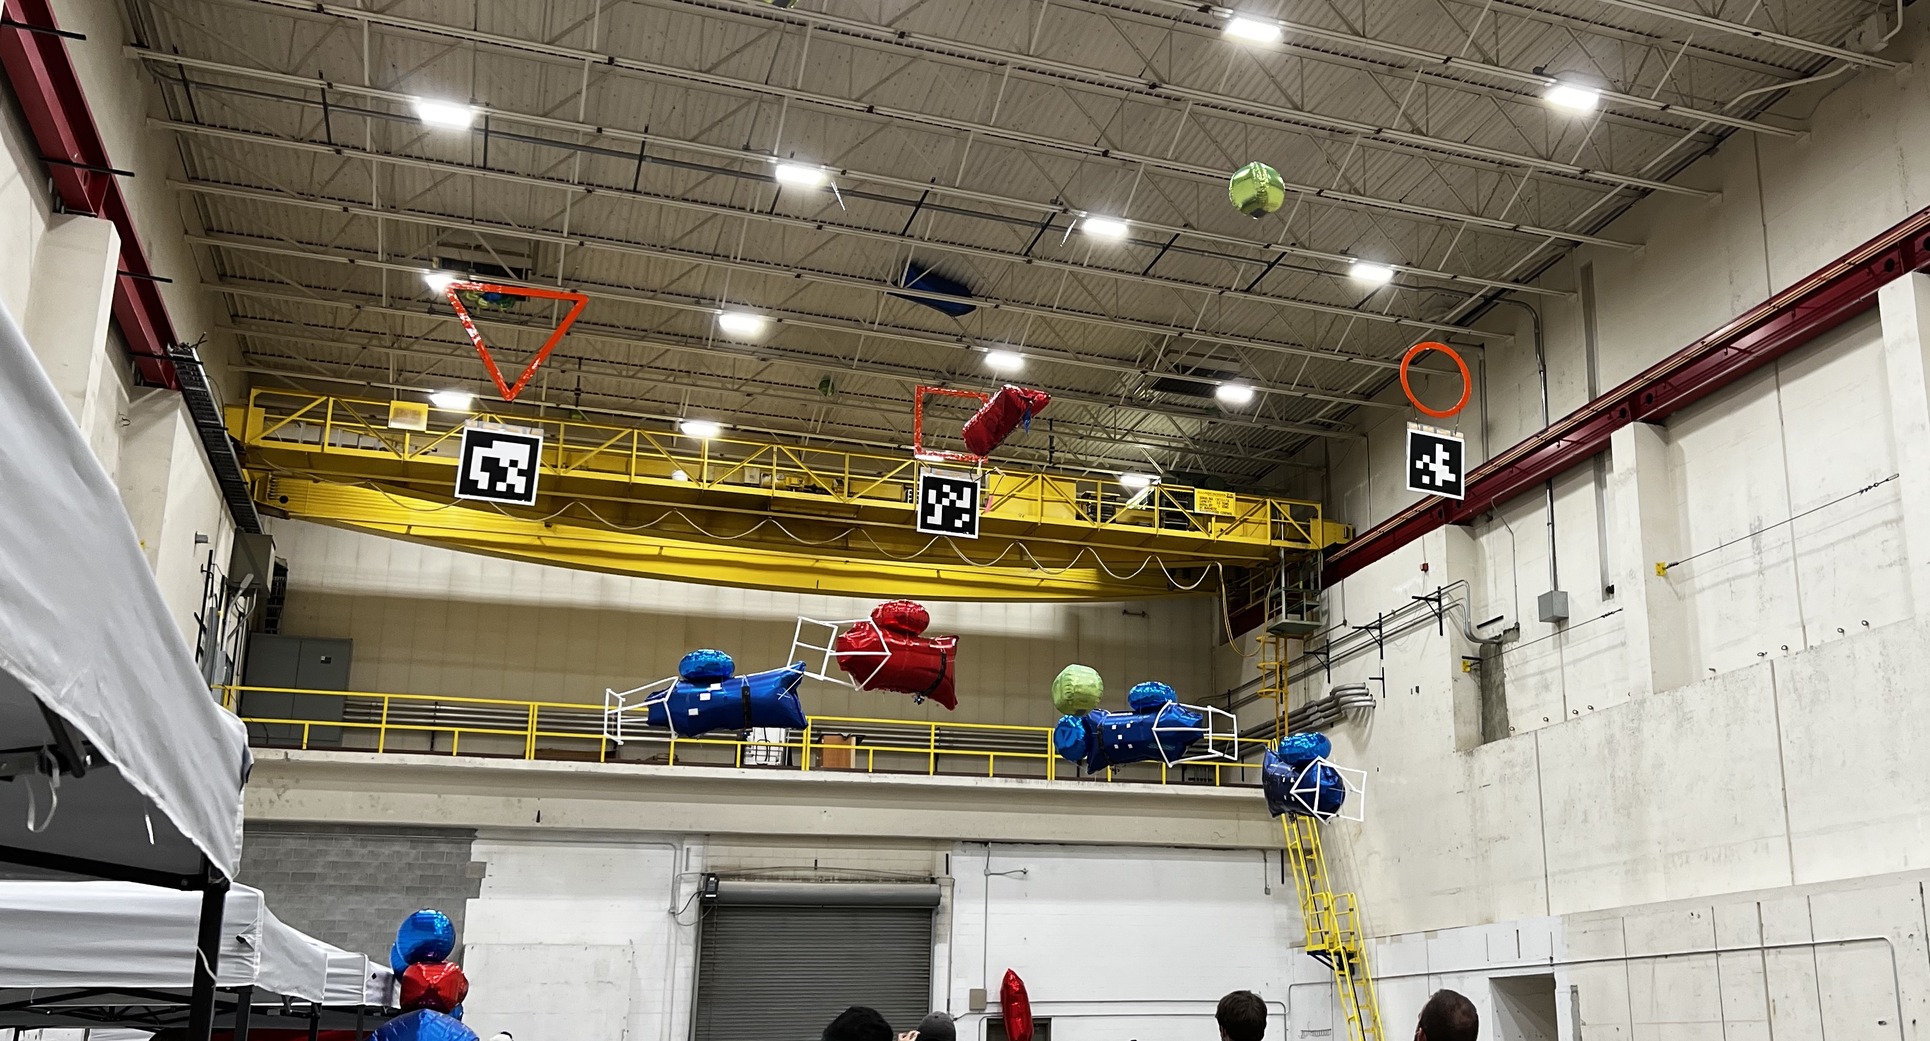
Environment (cont’d)
Goals
Square
Triangle
Circle
Orange and Yellow Retroflective
Color of interest dependent on home side
Fixed locations
Game ball
22” Round
Green/Yellow mylar
Randomly placed
Other teams’ vehicles

Slide 8
What are our constraints
For every 5:00 period must use Autonomy for 4:30
Can use manual control for :30
Schedule
time to acquire parts,
time to perform engineering (design, integration, testing)
Competition starts 4/18
Cost - $2-5K total budget
Size-Weight-Power (SWaP)
Size – no more than 50ft³ of He
Weight
Lift capacity of He is 0.06-0.07lb/ft³
~3lb total lift for 50ft³ (including balloon)
Negative buoyancy cannot exceed 100g
Power
LiPo – best power/weight ratio
Limited by weight
Enough power to last 30min game time (or method to swap batteries)
Others? –imposed or derived from required environment?
Strong air currents
Proximity to other blimps/obstacles

Slide 9
System Architecture
3 Layers of Architecture:
Functional – what functions will the system need to perform
Logical – grouping of functions into logical components
Physical – HW/SW components that realize logical components that perform functions

Slide 10
SE – Functional Design
Win the Game
Score Goal
Deny Goal
Maneuver System
Find Game Ball
Manipulate Game Ball
Find Goal
???

Slide 11
Flow Diagram – Scoring Goals
Maneuver System
Perform Ball Search Pattern
Maneuver to Ball
Perform Goal Search Pattern
Maneuver to Goal
Find Game Ball
Look for Ball
Ball Found
Manipulate Game Ball
Capture Ball
Find Goal
Look for Goal
Goal Found
Subject to Constraints

Slide 12
Maneuver Functional to Logical
Maneuver System
Perform Ball Search Pattern
Maneuver to Ball
Perform Goal Search Pattern
Maneuver to Goal
Follow Flight Pattern
Detect Position of Ball
Maintain course to ball
Follow Flight Pattern
Detect Position of Goal
Maintain course to goal
Flight Controller
Sensors
Subject to Constraints
*manual control
Joystick
Motors

Slide 13
Logical Decomposition
Joystick
Flight Controller
Sensors
Energy
Joystick Controller
Motors
Sensor Interface
Physical mounting
Motor Controller
Energy
Physical mounting
Energy
Physical mounting
Air Frame
Battery

Slide 14
Flight Controller Logical to Physical Design
Flight Controller
Pix Racer
Single Board Computer (Rpi)
Other
Pros:
Already Procured
Flight Controller SW Built in
Integrated motor controller
Joystick interface
Integrated IMU
Low-Mid SWaP
Cons:
Steep learning curve (time)
No camera interface
Limited sensor interfaces
May require separate telemetry interface
Pros:
?
Cons:
Not procured
Limited existing knowledge
Rpi Zero W 2
Rpi 4
Pros:
Low SWaP
Already Procured
Many functions alredy written
Multiple sensor interfaces
BT for Joystick interface
SSH for telemetry/offloading
Cons:
May require separate motor controller
Limited computational capacity
New interfaces require custom SW
Pros:
Reuse functions alredy written for Rpi Zero
Multiple sensor interfaces
BT for Joystick interface
Computational capacity for ML/Depth mapping
Cons:
HIGH SWap
May require separate motor controller
New interfaces require custom SW

Slide 15
How do we down select between options?
Test multiple configurations?
What are the criteria? Comparison against constraints?
What is the decision process?
Design with multiple configurations?
How do we divide efforts?
What is the decision process

Slide 16
Verification that Physical Design performs necessary functions
Flight Controller
Can also fulfill other logical roles
Joystick Controller
Single Board Computer (Rpi)
Sensor Interface
Follow Flight Pattern
Maintain course to ball
Follow Flight Pattern
Maintain course to goal

Slide 17
Repeat Process for all Functions
Find game ball
Manipulate game ball
Find goal

Slide 18
Division of labor
Individual design teams
Group design
Build/Integrate/Test Cycles

Slide 19
Maneuver Decompose into details
Maneuver System
Time
Cost
Manual Control
Autonomous Control
Joystick
Motors
Sensors
Control Input
Joystick Interface
Motor
Controller
Physical Mounting
Physical Mounting
Sensor Interface
Open Loop Control
Closed Loop Control
Flight Controller
Sensor Feedback
SWaP

